Slide 1
R
Association Mining (Market Basket Analysis)

Slide 2
Association mining is commonly used to make product recommendations by identifying products that are frequently bought together. But, if you are not careful, the rules can give misleading results in certain cases.

Slide 3
apriori algorithm
Association mining is usually done
on transactions data from a retail market or from an online e-commerce store.
Since most transactions data is large, the apriori algorithm makes it easier to find these patterns or rules quickly.

Slide 4
What is a rule?
So, What is a rule?
A rule is a notation that represents which item/s is frequently bought with what item/s. It has an LHS and an RHS part and can be represented as follows:
itemset A => itemset B
This means, the item/s on the right were frequently purchased along with items on the left.

Slide 5
How to measure the strength of a rule?
The apriori() generates the most relevent set of rules from a given transaction data.
It also shows the support, confidence and lift of those rules

Slide 6
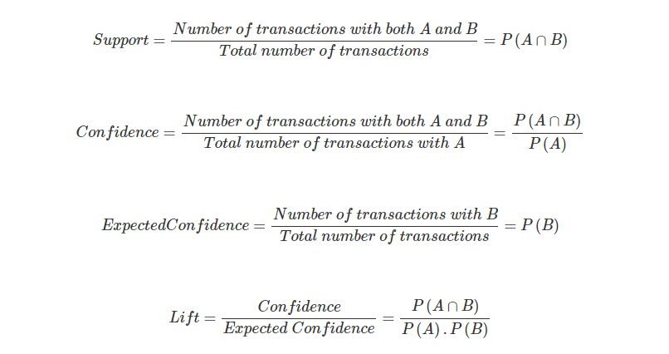

Slide 7
Lift is the factor by which, the co-occurence of A and B exceeds the expected probability of A and B co-occuring, had they been independent. So, higher the lift, higher the chance of A and B occurring together.
we cannot use lift to make recommendation for a particular directional ‘rule’. It can merely be used to club frequently bought items into groups.

Slide 8
Problem with using Confidence
The confidence of a rule can be a misleading measure while making product recommendations in real world problems, especially while making add-ons product recommendations. Lets consider the following data with 4 transactions, involving IPhones and Headsets:
Iphone, Headset
Iphone, Headset
Iphone
Iphone
We can create 2 rules for these transactions as shown below:
Iphone -> Headset
Headset -> IPhone
In real world, it would be realistic to recommend headphones to a person who just bought an iPhone and not the other way around. Imagine being recommended an iPhone when you just finished purchasing a pair of headphones. Not nice!.

Slide 9
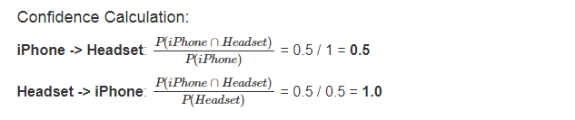
While selecting rules from the apriori output, you might guess that higher the confidence a rule has, better is the rule. But?

Slide 10
As, you can see, the
headset -> iPhone recommendation has a higher confidence, which is misleading and unrealistic. So, confidence should not be the only measure you should use to make product recommendations.

